Slide 1

Advocacy: The People
Change Agent Network Forum
You Can, I Can, We Can
May 25, 2017

Slide 2
Welcome
Notes:
NAME: Raquel
NOTE: NA
SCRIPT: NA

Slide 3



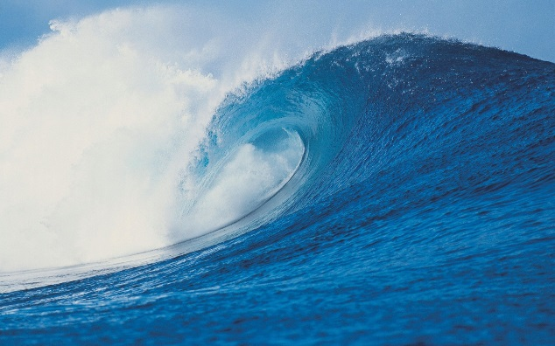
Why CAN Forums?
Change starts with an initial, often highly personal, commitment to engage and move forward.
-Dr. Paul Light, Driving Social Change, 2011
Notes:
NAME: Raquel
NOTE: NA
SCRIPT: CAN Forums were created to strengthen a network of change agents.
Vitalyst’s goal is for you to leave today’s session knowing other people, knowing that you are not alone, and with some practical skills and resources to build a stronger more effective organization.
This starts with self , like a drop in the water, and has the possibility of becoming a wave of transformation.

Slide 4
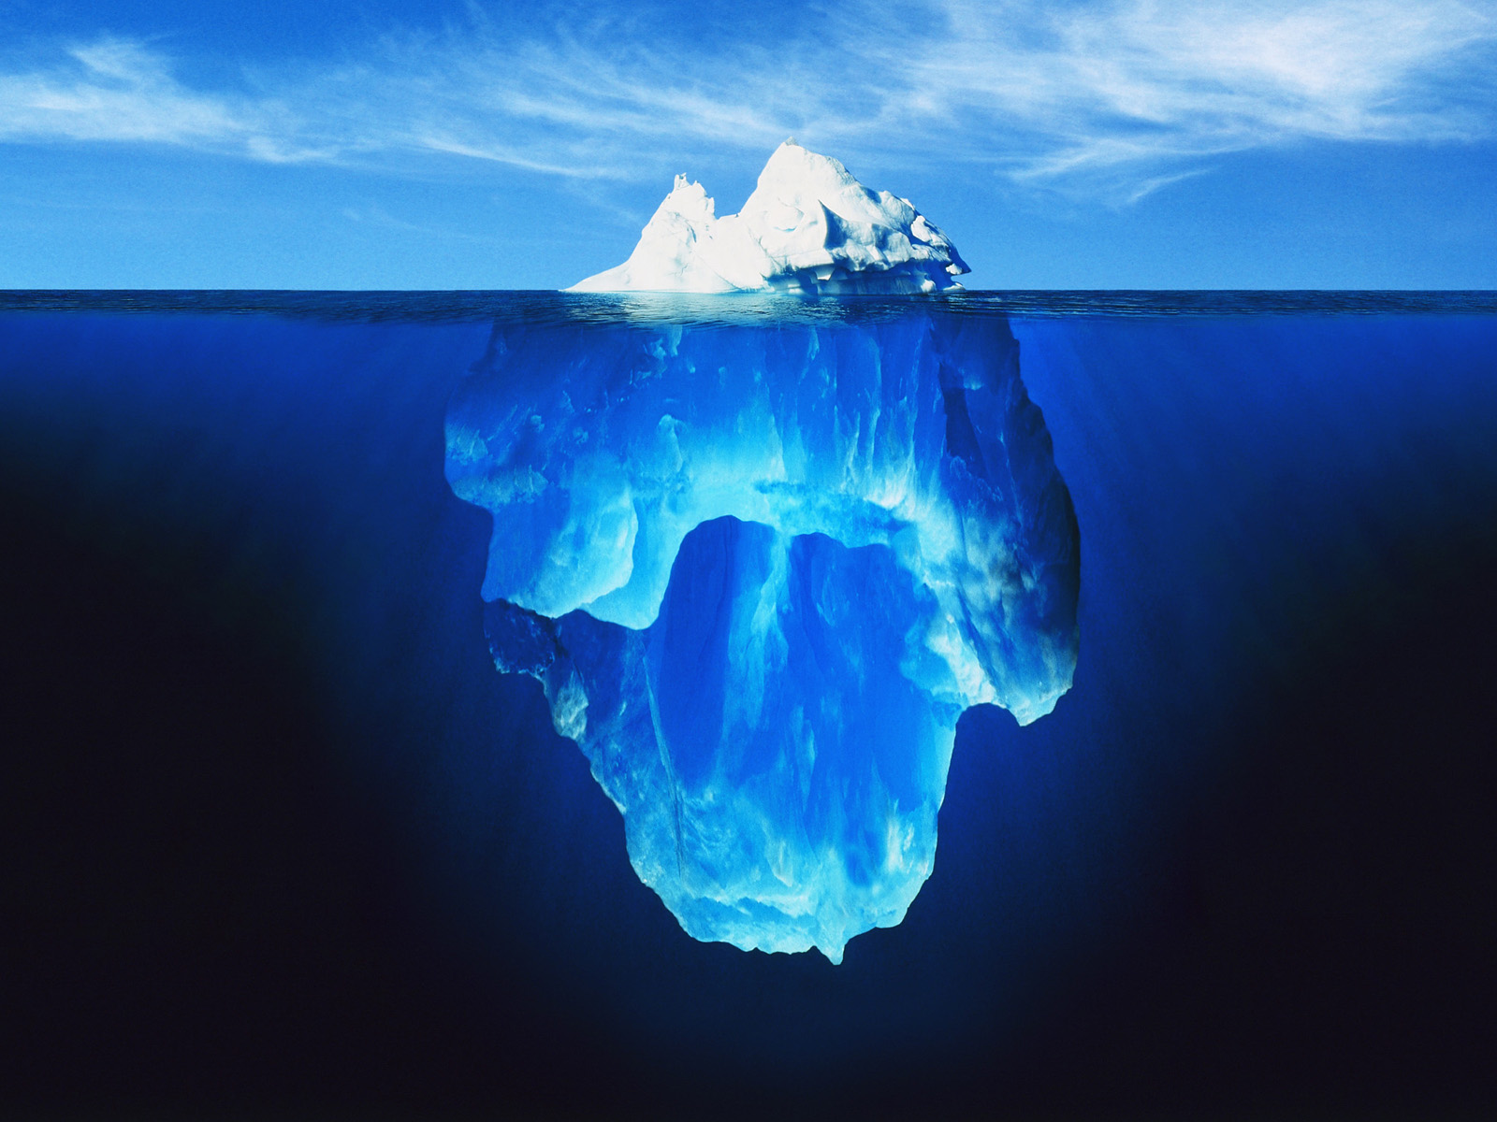

CAN Forum
Continual Learning
-
Self Motivation
Notes:
NAME: Raquel
NOTE: NA
SCRIPT: Please keep in mind. CAN Forums are a high level introduction to subjects that are often complex.
We respect and appreciate the diversity of experience on complex topics because it enriches the conversation, connects people with others who may have a different skill set and lived experience,
and because acknowledging together that something is complex is one step to knowing we are all in this together.

Slide 5
Agenda
Vitalyst Health Foundation overview
Year of Healthy Communities
Table introductions
CAN Forums 2017
Desired results for today
Guest presenter, Jeff Zetino
Notes:
NAME: Jennifer
NOTE: NA
SCRIPT: NA

Slide 6
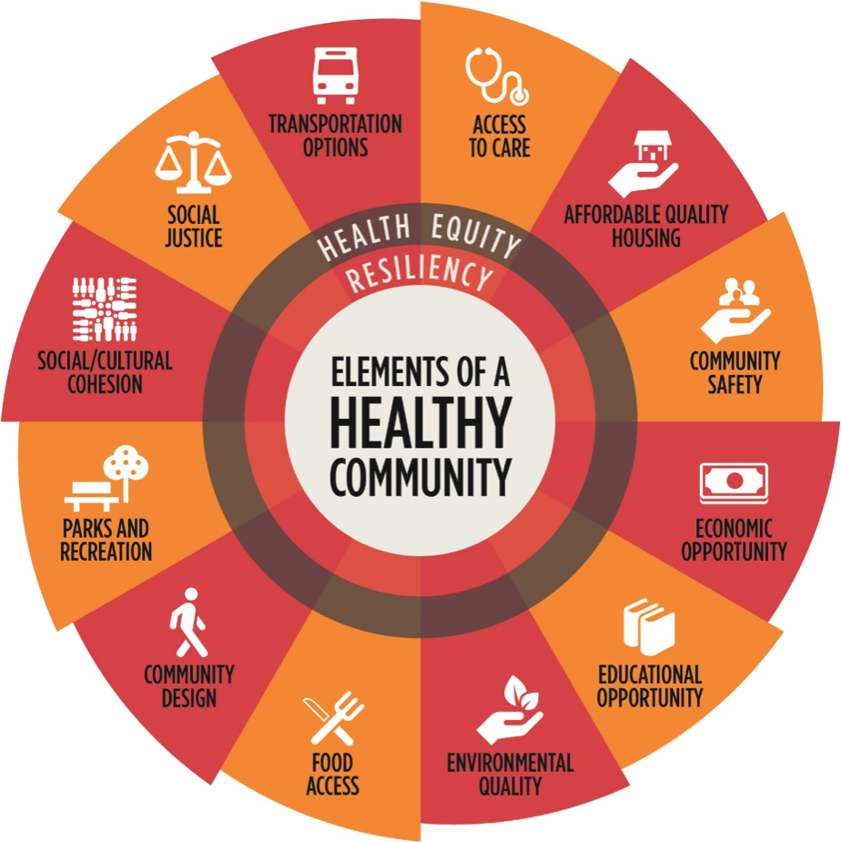
Table Introductions
Name
Organization/Affiliation
Briefly describe where your work fits into the Elements of Healthy Community
Notes:
NAME: Jennifer
NOTE: Refer to the handout in their folders
SCRIPT: Please share your name, organization, and where your work fits into the elements of healthy communities- just among your table.

Slide 7
2017 CAN Forums: Advocacy
YEAR OF HEALTHY COMMUNITIES
ADVOCACY
The Story | The People | The Resources | The Action
February 21, 2017 | May 25, 2017 | August 24, 2017 | November 16, 2017
Desert Willow Conference Center | Roosevelt Wellness Center | Roosevelt Wellness Center | Roosevelt Wellness Center
Building the story | Building the people | Building and aligning resources | Taking action
Notes:
NAME: Jennifer
NOTE: This is not in their folder. We can have it on the website.
SCRIPT: Here is our learning arc for this year’s CAN Forum.

Slide 8
Specific Desired Results of Today’s Session
Identify the elements of a healthy coalition in advocacy
Understand the basics of the boundaries of their role, authority and task in the work they do in advocacy
Recognize the importance of building a shared vision and common outcomes
Build networks and coalitions that promote specific causes
Notes:
NAME: Jennifer
NOTE: None
SCRIPT: Desired results set the ground for expectations about what we are trying to achieve in this session…

Slide 9
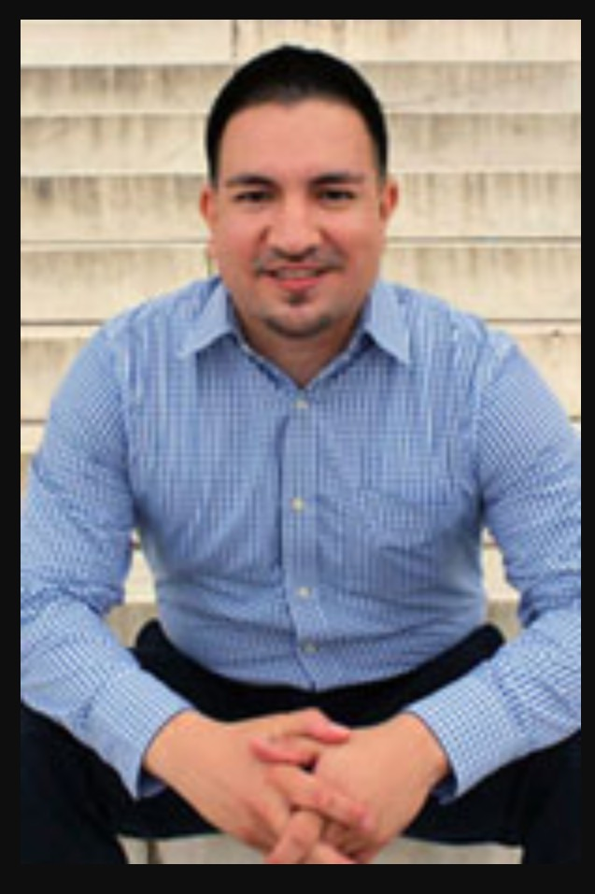
Guest Presenter
Jeffrey Zetino Preventative Health Collaborative Supervisor Maricopa County Public Health

Slide 10
ADVOCACY
Building the People
Jeff Zetino
Preventive Health Collaborative
Maricopa County Department of Public health
Consultant and Faculty for VHF Agents of Community Transformation

Slide 11
Topics to be covered
During each section:
Context
Table Discussion
Action Commitment
Purpose
Structure
Power

Slide 12
Purpose

Slide 13
What are we going to do?
How will we do this?
Who is going to do this?
Why should we do this?
By when are we going to do this?
Why should I care?
Why is this work more important than my paying job?
If you don’t have the answers to these questions – then you better have a plan on how you will figure them out and how you will include your stakeholders in developing that plan.
“To provide purpose in the face of uncertainty”

Slide 14
We Don’t Need Brilliant Ideas…
  We need a disciplined and authentic approach to building deep relationships with community, the practice of listening for unifying challenges and the extremely hard work of turning intentions into reality.

Slide 15
A process of discovery
Building relationships with your community and understanding their priorities.
Qualitative
1 on 1’s
Forum
Sharing a Lunch/ Coffee
Developing a Relationship
Sharing your Story
Listening to others’ Story
Lived Experience
Understanding the outcome measures and the priorities of your stakeholders
Quantitative
Census Data
Community Assessments
Research Papers
Community Health Assessment/ Community Health Improvement Plan
State Health Assessments/ State Health Improvement Plan
Institutional Strategic Plans
Data

Slide 16
What is our role?
How do we fill the gap?
What should our coalition focus on?
Raise Awareness of Issues
Build Relationships Amongst Stakeholders
Increase Capacity/ Skill
Focus on Network Improvement
Small P Policy Change
Organize Organizations to Advocate for Policy Change
Organize People to Advocate for Change
What no one else is doing
What our partners are already working on
What we have the capacity to do
Gaps
Collaboration

Slide 17
Table Discussion
Do I feel connected to those I work with? Why/ Why not
Do we ever talk about hopes, dreams, fears, frustrations and aspirations? Why/ Why not
How can we develop stronger relationships amongst our partners?

Slide 18
Structure

Slide 19
Form
Follows
Function

Slide 20
Hierarchy
&
Bureaucracy
Interdependent Leadership
Organizing Team
Team Lead
Team Lead
Team Lead
Team Lead
Team Lead
Leader
Manager
Manager
Manager
Staff
Staff
Staff
Staff
Growth Through
Relationships
Control

Slide 21

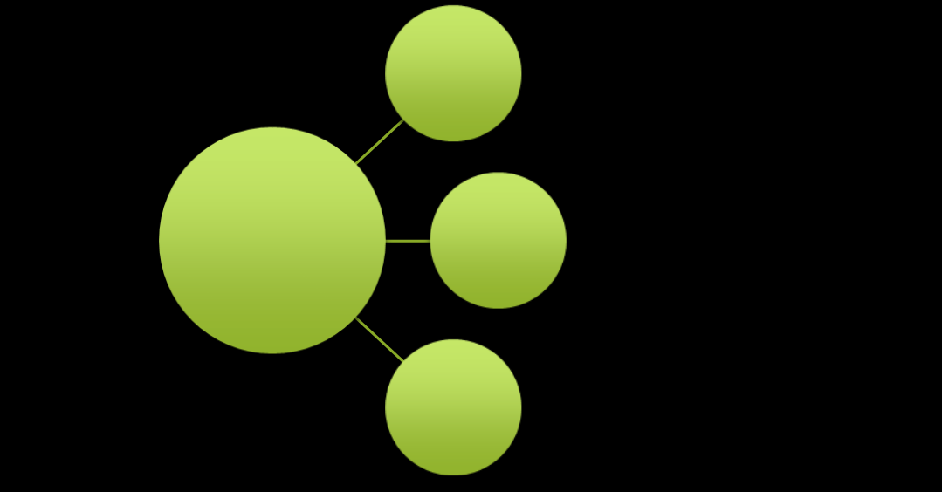
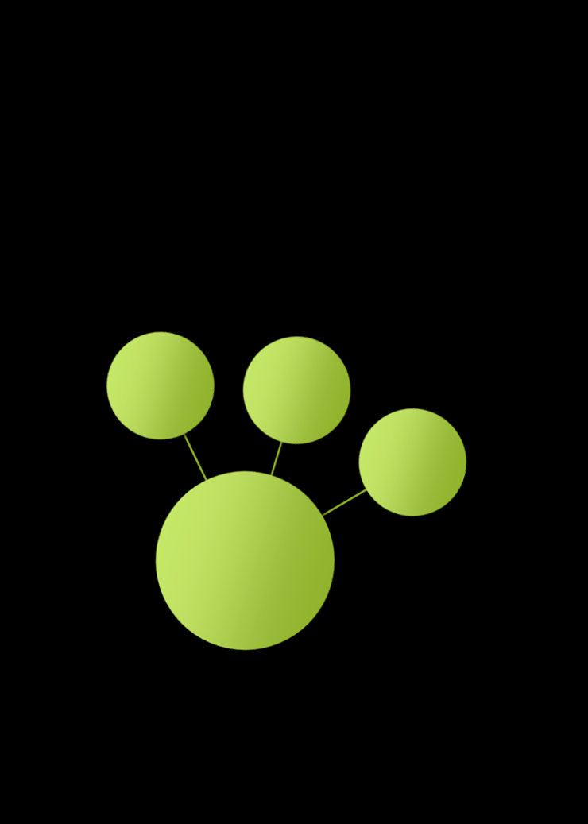
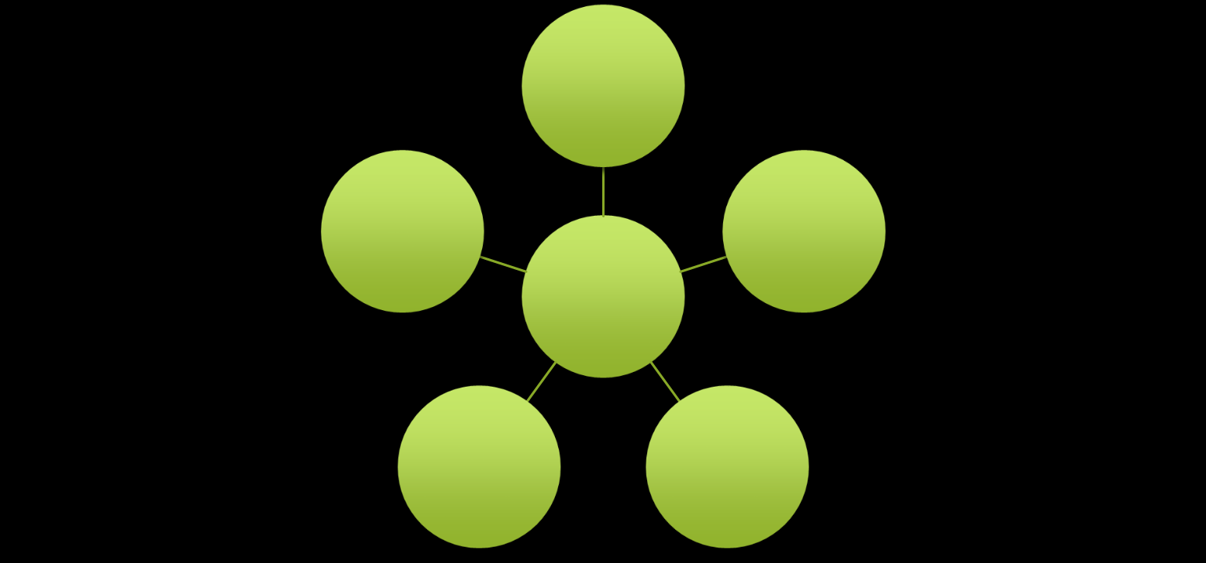
Proliferation of Action
Movement
Building
Based on
Autonomy
Mastery &
Purpose
Team Member
Team Member
Team Member
Team
Lead
Team
Lead
Team
Lead
Team
Lead
Organizing
Team

Slide 22
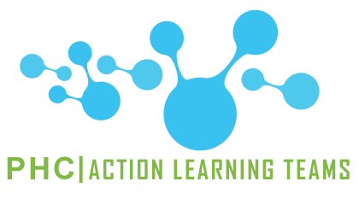

ALT Coach
Team
Lead
Support to Catalyze Action
Convener
Historian
Facilitator
Strategic Planning
Action Planning

Slide 23
ALT Coach
Food
Systems

Slide 24
North
Phoenix
ALT Coach
Food
Systems
West
Mesa

Slide 25
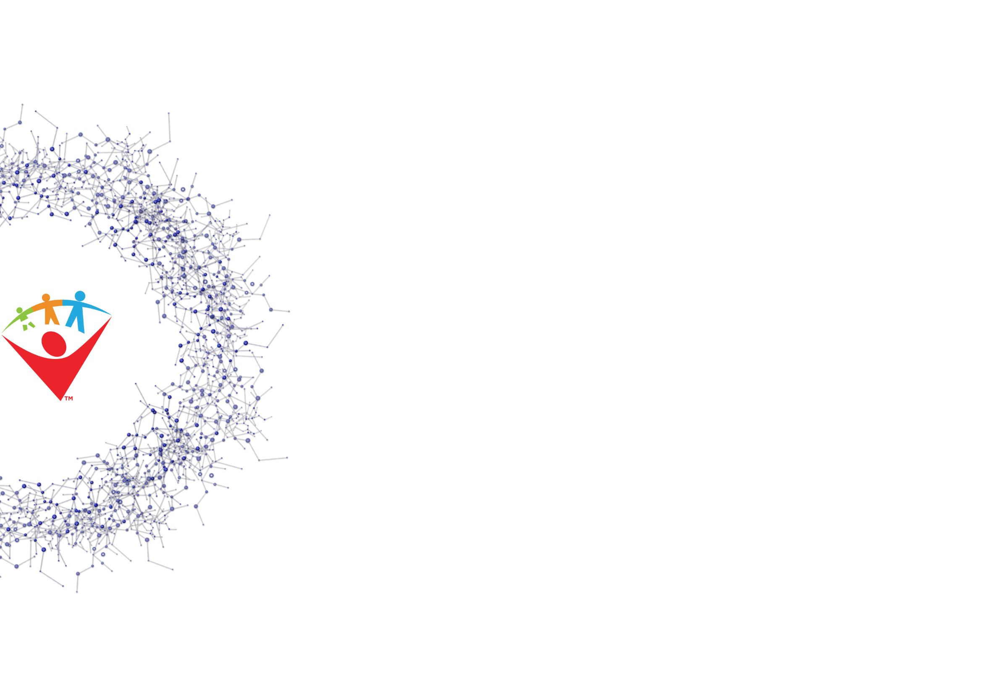
Structure
Preventive health Collaborative
Network
Capacity Development
Information Sharing
Relationship Building

Slide 26
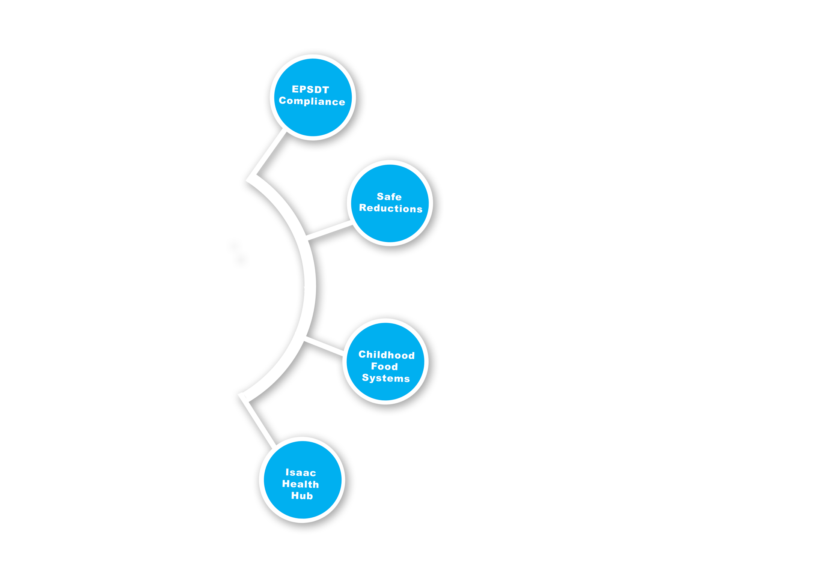
Structure
Preventive health Collaborative
ALTs
Cross-Sectoral Projects
PSE Focused
Results Based
Adaptive Leadership

Slide 27
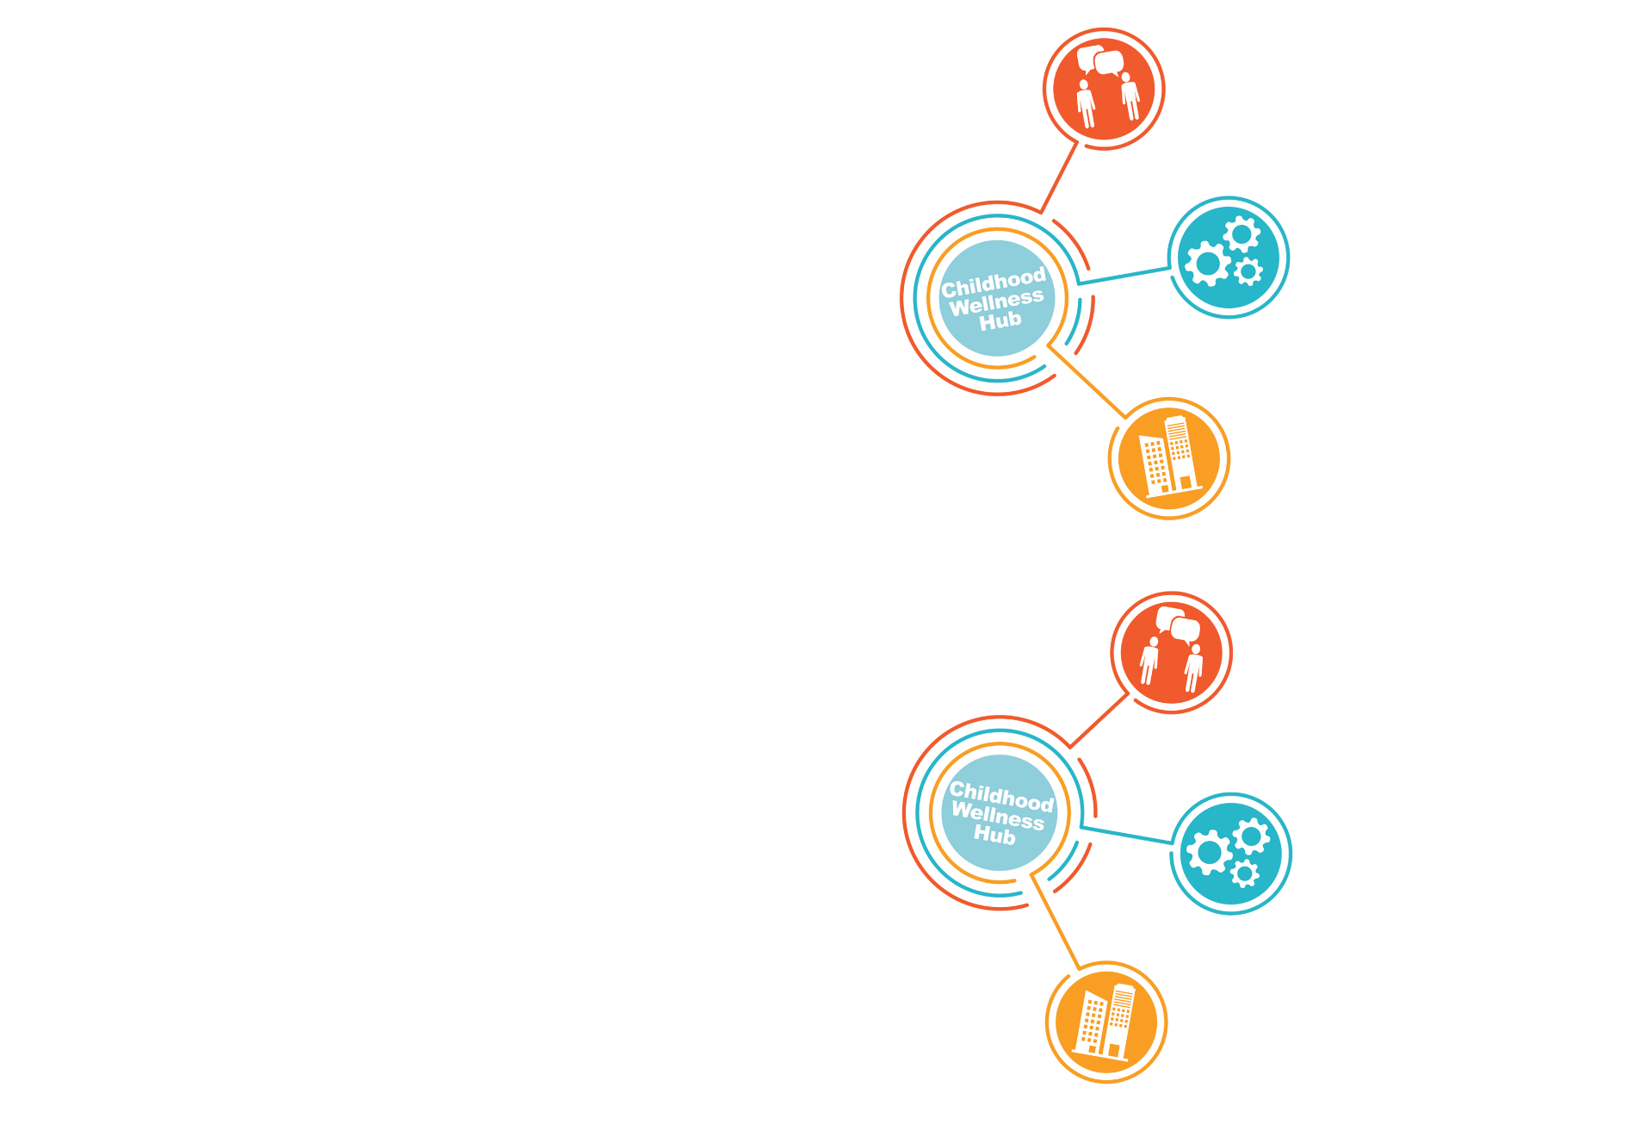
Structure
Preventive health Collaborative
Targeted
Pilot
Projects

Slide 28
Table Discussion
Does your coalition have roles, tasks and expectations?
What type of support & authority is given to your Committee Chairs, Team Leads, Workgroup Leads?
Why are coalitions vague in articulating expectations, why don’t we ask for clarity?

Slide 29
Power

Slide 30
Power
Un-Organized
Organized
Organizations
Institutions
Funders
Political Parties
Media Associations

Slide 31
Can Non-Profits and Gov Programs Advocate?
  Yes, but we cannot Lobby
  We can do: Research, Analysis, Issue Framing, Educate the public, Media Advocacy, Executive Branch Advocacy, Administrative Advocacy, Legislative Education, Judicial Branch Advocacy, Voter Registration, Voter Education.

Slide 32
What is Community Organizing?

Slide 33
Community Organizing Efforts:
Analyze their community’s power structure and build the power necessary to change it.
Prioritize leadership by people who are most affected by the issues of concern, rather than those who are professionally or politically involved in working on those issues.
Develop a capacity for conflict when it is necessary to drive important changes in policies and systems.

Slide 34
Change
Institutions
Community

Slide 35
Institutional
Technical Expertise
Data Driven
Small PSE Focused
Conflict Adverse
Hybrid
Community
Organizing
Resident Leadership
Lived Experience
Big P Advocacy
Capacity for Conflict
Do we institutionalize community organizing through Capacity Development and training of current staff?
Do we intentionally hire community organizers to staff more coalitions?
How do we include Community Organizing Organizations in our Coalitions?

Slide 36
In closing…
Are we really ready to challenge the status quo?
Are you ready for the accountability that systems change work asks of you?
Are you ready to hold the people with power over you and our communities accountable?
Please write down 3-5 action steps you will follow up with in the next 2-4 weeks. What do you need to learn, Who do you need to talk to, what do you need to do?

Slide 37
Thank you
Jeff Zetino
Preventive Health Collaborative
Maricopa County Department of Public health
Consultant and Faculty for VHF Agents of Community Transformation
JeffreyZetino@mail.Maricopa.gov
602.300.7025

Slide 38
Strong Teams Usually Have
Clarity of Purpose
  We know why we are here, We know why we exist.
Well Articulated Plan
  That addresses Culture, Regulation or Systems Change Efforts.
Clear Roles & Tasks
  Why am I here? What am I contributing? What is my role? What am I expected to do?
Accountability to One Another
  Accountability based on strong relationships to one another.

Slide 39
Jeffrey Zetino, MPA, MSW
Preventative Health Collaborative
Maricopa County Public Health
JeffreyZetino@mail.Maricopa.gov
www.setforlifeaz.org
(602) 506-6900
Jennifer Bonnett, MPA
JHB Executive Consultants
jennifer@jhbconsultants.com
www.jhbconsultants.com
(602) 529-4697
Dr. Raquel Gutierrez
Director of Strategic Learning & Practice
Vitalyst Health Foundation
Rgutierrez@VitalystHealth.org
www.VitalystHealth.org
(602) 385-6500
Notes:
NAME: NA
NOTE: NA
SCRIPT: NA

