Slide 1

Advocacy: The People
Sponsored by the Capacity Builders Network
May 25, 2017

Slide 2
Welcome

Slide 3
Agenda
Vitalyst Health Foundation overview
Year of Healthy Communities
Table introductions
CAN Forums 2017
Desired results for today
Guest presenter, Jeff Zetino
Notes:
I plan to introduce the theme of advocacy for the 2017 year and the four subsections. I don’t know if you want the detail in here about the can forums.

Slide 4




Why CAN Forums?
Change starts with an initial, often highly personal, commitment to engage and move forward.
-Dr. Paul Light, Driving Social Change, 2011
Notes:
CAN Forums were created to strengthen a network of change agents.
Vitalyst’s goal is for you to leave today’s session knowing other people, knowing that you are not alone, and with some practical skills and resources to build a stronger more effective organization.
This starts with self , like a drop in the water, and has the possibility of becoming a wave of transformation.

Slide 5
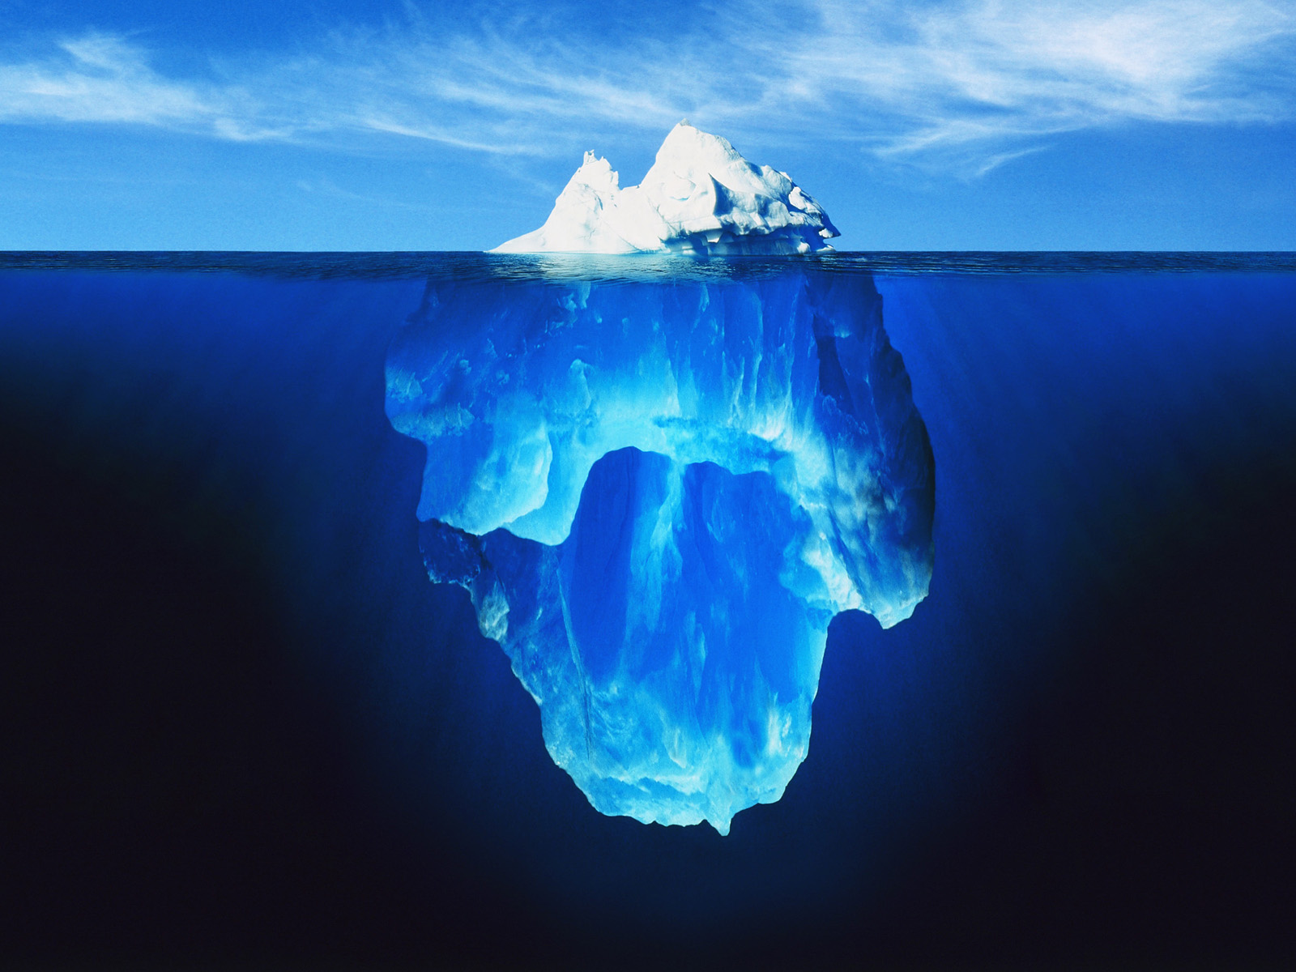

CAN Forum
Continual Learning
-
Self Motivation
Notes:
Please keep in mind. CAN Forums are a high level introduction to subjects that are often complex.
We respect and appreciate the diversity of experience on complex topics because it enriches the conversation, connects people with others who may have a different skill set and lived experience,
and because acknowledging together that something is complex is one step to knowing we are all in this together.

Slide 6
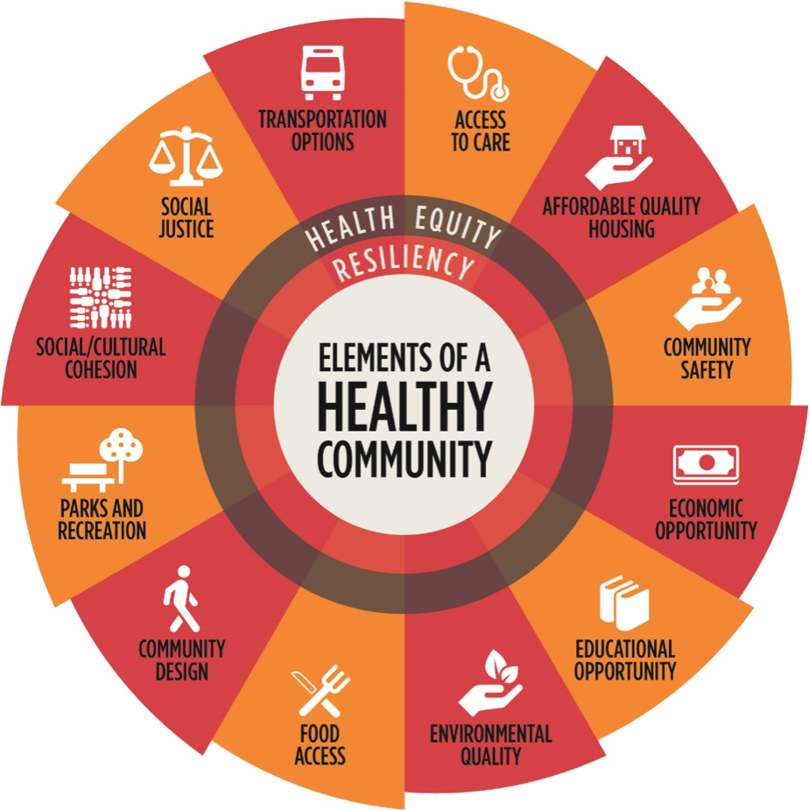
Table Introductions
Notes:
Please share your name, organization, and where your work fits into the elements of healthy communities- just among your table.

Slide 7
2017 CAN Forums: ADVOCACY
YEAR OF HEALTHY COMMUNITIES
ADVOCACY
The Story | The People | The Resources | The Action
February 21, 2017 | May 25, 2017 | August 24, 2017 | November 16, 2017
Desert Willow Conference Center | Roosevelt Wellness Center | Roosevelt Wellness Center | Roosevelt Wellness Center
Building the story | Building the people | Building and aligning resources | Taking action

Slide 8
Specific Desired Results of Today’s Session
Identify the elements of a healthy coalition in advocacy
Understand the basics of the boundaries of their role, authority and task in the work they do in advocacy
Recognize the importance of building a shared vision and common outcomes
Build networks and coalitions that promote specific causes

Slide 9
Jennifer Bonnett
JHB Executive Consultants
jennifer@jhbconsultants.com
www.jhbconsultants.com
(602) 529-4697
Notes:
NAME: RDG
NOTE:
SCRIPT:

